Slide 1

Graph Traversal: Breadth First Search Depth First Search
Exercise Question

Slide 2
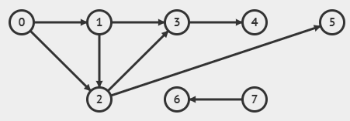
Breadth First Search
For each of the given graph, perform the Breadth First Search:
Mention the source (starting node) for Traversal
Show all the steps of traversal in detail by maintaining Queue and Visited Nodes
Create the Traversal Trees with levels

Slide 3
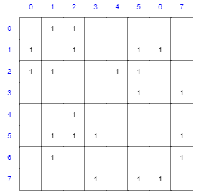
Breadth First Search
For the given adjacency matrix draw graph.
Mention the source (starting node) for Traversal
Show all the steps of traversal in detail by maintaining Queue and Visited Nodes
Create the Traversal Trees with levels

Slide 4
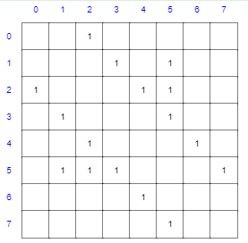
Depth First Search
For each of the given graph, perform the Depth First Search:
Draw the graph against given adjacency matrix
Mention the source (starting node) for Traversal
Show all the steps of traversal in detail by maintaining Stack and Visited Nodes
Create the Traversal Trees with levels

